Slide 1
IS1110-Communication Skills
Communication in
Organization
Assignment 01
Group 05-CIS

Slide 2
CONTENT
1. Introduction
2. Importance of communication in organization
3. Internal Communication
Stakeholders
Channels
4. External Communication
Stakeholders
Channels
5.Conclusion
01

Slide 3


INTRODUCTION
What is the meaning of Communication in organization?
Organized communication is a term that covers all communication employed by a company and its representatives.
Effective organizational communication creates an environment where your business can thrive.
02

Slide 4

IMPORTANCE OF COMMUNICATION IN ORGANIZATION
It helps to create a company brand
It allows managers to set staff policies
It makes it easier to respond to unforeseen events
It keeps all staff focused on the same goals
It helps maintain a positive workspace
It facilitates change and growth
It improves your company's public image
03

Slide 5

INTERNAL COMMUNICATION
Internal communication entails the methods an organization uses to communicate among staff.
Covers a broad range of communication styles, such as written and oral, across different organizational tiers and levels of formality.
Effective internal communication uses a mix of communication styles in different situations to let everyone in an organization interact more effectively
04

Slide 6

STAKEHOLDERS OF INTERNAL COMMUNICATION
1. Employees
2. Management
3. Executive leadership
4. Human Resources
5. Internal Communication Specialists
6.IT Department
05

Slide 7

CHANNALS OF INTERNAL COMMUNICATION
1.Email
2.Intranet
3.Instant messaging and Chatting tools
4.Meating
5.Internal social media
06

Slide 8

EXTERNAL COMMUNICATION
External communication involves the ways organizations interact with audiences outside their internal environment, such as customers, partners, investors, and the public.
The primary goal is to build relationships, enhance reputation, and promote products or services.
Effective external communication is essential for influencing public perception and achieving business objectives.
07

Slide 9
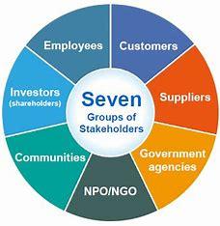
STAKEHOLDERS OF EXTERNAL COMMUNICATION
1.Customers
2.Supliers
3.Government agent
4.Communities
5.Employees
08

Slide 10
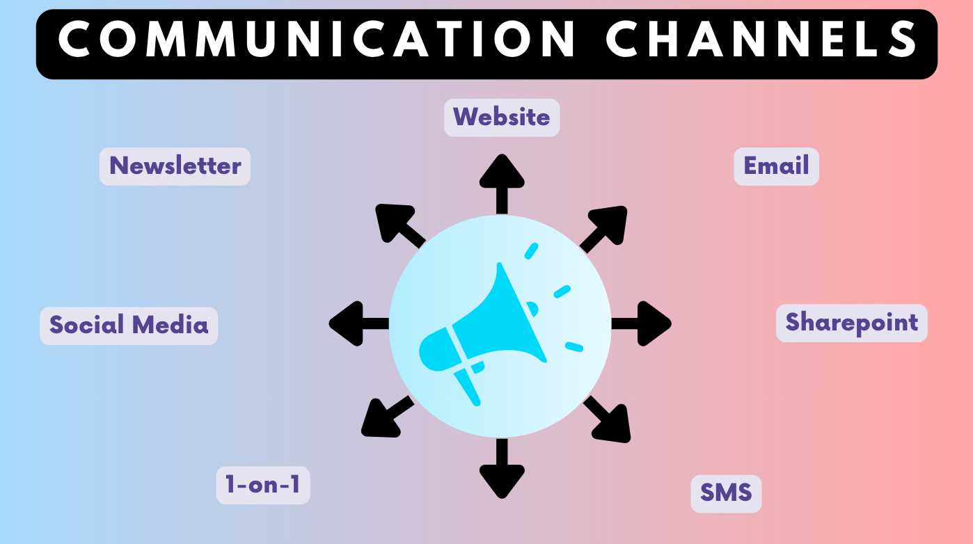
CHANNELS OF EXTERNAL COMMUNICATION
1.Social media
2.News letters
3.Direct mail
4.Websites & blogs
5.Advertising
6.Public speaking & events
7.Sponsorships & Partnerships
8.Customer support channels
9.Press Release
09
10.Corporate Social Responsibility

Slide 11
CONCLUSION
Internal communications effectively align internal groups within an organization by focusing on common goals.
external communication with stakeholders and scrollers is also quite important and needs to be the same across all channels.
It is with these forms of strategic management that trust, collaboration, and success can be developed inside organizations
10
13

Slide 12
Group 05-CIS members
22CIS0270
-Bimsara-
22CIS0273
-Pasindu-
22CIS0271
-Anoj-
22CIS0274
-Sandani-
22CIS0272
-Chamindu-
22CIS0275
-Kaveesha-
11

Slide 13
Thank you!
12

